Slide 1

KRDS × LIV GOLF · CHINA LAUNCH PROPOSAL
2026
THE BIG IDEA
GOLF IT OUT
一杆见真章
Official China launch · Digital strategy & creative proposal · KRDS Greater China
01 / 35

Slide 2
EXECUTIVE ANSWER
KRDS × LIV
IN ONE SENTENCE
LAUNCH LIV IN CHINA NOT AS A GOLF EVENT —
BUT AS GOLF'S FIRST TEAM-FIGHT LEAGUE.
A Greater China operating system that turns 13 teams, captains and
rivalries into the entry point Chinese audiences can pick, follow and rally behind.
PLATFORM IDEA
DIGITAL HOME
ENGINE
Golf It Out / 一杆见真章
WeChat Mini Program as official China hub
Two campaigns × always-on team league content
LIV GOLF CHINA · DIGITAL LAUNCH PROPOSAL
02 / 35

Slide 3
THE BRIEF, OUR READ
KRDS × LIV
WHAT LIV NEEDS
FROM CHINA DIGITAL.
THE BRIEF
OUR READ
Build brand awareness and community on
relevant digital platforms in China. Ticketing
and eCommerce out of scope. Digital strategy
first. 48-hour planning window.
The real job is to give Chinese audiences
a reason to care before they understand golf —
and an official China home (Mini Program)
where that fandom is captured and grown.
LIV GOLF CHINA · DIGITAL LAUNCH PROPOSAL
03 / 35

Slide 4
MARKET OPPORTUNITY
KRDS × LIV
WHY CHINA.
WHY NOW.
500K
1M
93K+
2
registered golfers in Mainland China (R&A 2024)
9/18-hole golfers in Mainland China (R&A 2024)
registered junior golfers in China (R&A 2024)
Greater China beachheads — IS China + LIV HK
Source: R&A Global Golf Participation Report 2024. LIV Golf League public data.
LIV GOLF CHINA · DIGITAL LAUNCH PROPOSAL
04 / 35

Slide 5
CATEGORY PROBLEM
KRDS × LIV
GOLF IN CHINA
STILL FEELS LIKE
A CLUB,
NOT A CULTURE.
Perceived as private, expensive, old.
Scoring and formats feel technical to casual viewers.
Tournaments are stand-alone events, not seasons.
No clear team, captain, or rivalry to follow.
Lifestyle and youth have no obvious entry point.
LIV GOLF CHINA · DIGITAL LAUNCH PROPOSAL
05 / 35

Slide 6
COMPETITIVE CONTEXT
KRDS × LIV
WHERE LIV SITS IN
CHINA'S SPORT LANDSCAPE.
PROPERTY
FORMAT
CHINA FOOTPRINT
FAN ENTRY
PGA Tour / DP World
Individual stroke play
Core golf familiarity
Player loyalty
Int'l Series China
Asian Tour pathway
2026 China runway
Local talent
Simulator / indoor golf
Lifestyle leisure
Trial-led social buzz
Trying the sport
F1 / NBA China
Season storytelling
Established social ecosystem
Pick a team / star
LIV Golf
Team league, no cuts
Mainland runway + HK heritage
Pick a side
LIV gives golf a league-shaped entry point: teams, captains, standings and sides to pick.
LIV GOLF CHINA · DIGITAL LAUNCH PROPOSAL
06 / 35

Slide 7
PRODUCT TRUTH
KRDS × LIV
TRADITIONAL GOLF ASKS
“WHO PLAYED BEST?”
LIV ASKS
“WHOSE SIDE ARE YOU ON?”
13 teams. 13 captains. 57-player field. 72 holes. Shotgun start. No cuts.
Season standings turn every event into part of an ongoing rivalry.
LIV GOLF CHINA · DIGITAL LAUNCH PROPOSAL
07 / 35

Slide 8












MEET THE LEAGUE
KRDS × LIV
13 TEAMS.
13 SIDES TO PICK.
4ACES GC
CLEEKS GC
CRUSHERS GC
FIREBALLS GC
HYFLYERS GC
KOREAN GOLF CLUB
LEGION XIII
MAJESTICKS GC
OKGC
RANGEGOATS GC
RIPPER GC
SOUTHERN GUARDS GC
TORQUE GC
THE VETERAN
THE OUTLAW
THE PRODIGY
THE STYLIST
THE LOCAL HERO
Major-winners.
Experience pays.
Defectors with
something to prove.
Young guns
breaking records.
Crowd-pleasers
with flair.
Asia heritage —
why China cares.
FIVE FAN-CHOICE ARCHETYPES BEHIND 13 TEAMS · TEAM MARKS © LIV GOLF LEAGUE — PITCH ILLUSTRATION ONLY
LIV GOLF CHINA · DIGITAL LAUNCH PROPOSAL
08 / 35

Slide 9
TARGET AUDIENCES
KRDS × LIV
THREE AUDIENCES.
ONE EMOTIONAL DOOR.
LIFESTYLE
CURATORS
MODERN BUSINESS
PROFESSIONALS
EXISTING GOLF
FANS & PLAYERS
Young urban (SH/BJ/SZ/GZ/CD).
RED, Douyin, fashion, fitness.
Golf as content-worthy scene.
Finance, consulting, tech, luxury.
Know golf as networking,
want a more modern version.
Club golfers, junior parents,
HK & Greater Bay community.
Want credibility and depth.
ENTRY POINT
ENTRY POINT
ENTRY POINT
Team style, captain personalities,
event atmosphere, music.
Team strategy, leadership,
premium hospitality.
Player profiles, leaderboard,
format education, HK heritage.
+ 93K REGISTERED JUNIOR GOLFERS (R&A 2024) — FAMILIES WHERE GOLF IS A 升学 ASSET; PARENT-LED WEDGE INTO ALL THREE SEGMENTS.
LIV GOLF CHINA · DIGITAL LAUNCH PROPOSAL
09 / 35

Slide 10
THE BIG IDEA
GOLF IT OUT
一杆见真章
Stop talking. Stop posturing. Settle it on the course.
The Chinese line carries 武侠 register — show your true skill in a single stroke.
10 / 35

Slide 11
WHY THIS WORKS FOR CHINA
KRDS × LIV
WHAT LIV CAN BORROW
FROM LEAGUE FANDOM:
ALLEGIANCE BEFORE EXPERTISE.
A MODEL — NOT A FORECAST. THE PRINCIPLES THAT GROW LEAGUE FANDOM EVERYWHERE.
TEAMS BEFORE RULES
Pick a side before learning the format.
CAPTAINS BEFORE FORMATS
Star personalities pull fans in.
RIVALRIES BEFORE SCORING
Conflict carries the season.
HIGHLIGHTS BEFORE TOURNEYS
Moments travel; education follows.
LEADERBOARDS AS STORIES
Tables become drama, not data.
LIV GOLF CHINA · DIGITAL LAUNCH PROPOSAL
11 / 35

Slide 12
THE SOCIAL LEAGUE TRUTH
KRDS × LIV
应酬 2.0 · THE NEW RITUAL
应酬 2.0.
GOLF IS THE NEW 局.
LIV MAKES IT A LEAGUE.
The upgraded ritual for younger business China — same 局, no judgment, more shareable.
WHY GOLF IS THE NEW 局
WHAT LIV ADDS ON TOP
高尔夫搭子 — peer-group ritual, modern face.
Pick a team = instant common ground.
4-5 hrs together = real talk, not pitch decks.
Captain rivalries replace forced small talk.
Outdoor, low-pressure, alcohol-optional.
Team standings to predict, joke, debate.
Mixed company welcome — peers, partners, family.
Group fandom > solo spectatorship.
Multi-generation asset — junior + family golf.
13 ways to bond, not one.
AUDIENCE 02 UNLOCK — MODERN BUSINESS PROFESSIONALS, MAINLAND + HK.
LIV GOLF CHINA · DIGITAL LAUNCH PROPOSAL
12 / 35

Slide 13
GREATER CHINA LOCALIZATION
KRDS × LIV
TWO MARKETS.
ONE LEAGUE.
MAINLAND CHINA
HONG KONG
Language: Simplified Chinese, Mandarin-first
Tone: competitive, social, educational without jargon
Channels: WeChat, Channels, Douyin, RED, Weibo
Angle: team rivalry, star players, leaderboard
drama, lifestyle entry through RED/Douyin
Language: Traditional Chinese, Cantonese-first
Tone: local, proud, event-driven, culturally specific
Channels: WeChat, IG/FB/YT, cross-border content
Angle: LIV HK heritage, Fanling, Cantonese fan voice,
Greater Bay travel & weekend energy
LIV GOLF CHINA · DIGITAL LAUNCH PROPOSAL
13 / 35

Slide 14
PLATFORM ECOSYSTEM
KRDS × LIV
WHERE LIV LIVES
IN CHINA.
WeChat Mini Program
WeChat OA
WeChat Channels
Douyin
OFFICIAL CHINA HUB
AUTHORITY & LONG-FORM
SHORT VIDEO, IN-WECHAT
AWARENESS, HIGHLIGHTS, DRAMA
RED / Xiaohongshu
Weibo
Bilibili
KOL / KOC network
LIFESTYLE & SOCIAL PROOF
TRENDING MOMENTS, KOL AMP
SPORTS LONG-FORM, 二创 HOME
ALLEGIANCE MADE VISIBLE
+ KUAISHOU (T2/T3, JUNIOR GOLF FAMILIES) · WECOM (B2B CRM, HOSPITALITY) · IP COLLABS (王者 · 原神 · LPL)
LIV GOLF CHINA · DIGITAL LAUNCH PROPOSAL
14 / 35

Slide 15
WECHAT MINI PROGRAM
KRDS × LIV
THE OFFICIAL CHINA
DIGITAL HOME OF LIV.
In China, official discovery happens inside platform ecosystems, not brand websites.
Live leaderboard
Pick Your Team selector
Team hub (13 teams)
Player profiles
How LIV works — 101
Mainland hub (IS pathway)
Hong Kong hub (LIV HK)
Content feed
CRM & event reminders
LIV GOLF CHINA · DIGITAL LAUNCH PROPOSAL
15 / 35

Slide 16
MINI PROGRAM USER JOURNEY
KRDS × LIV
DISCOVERY TO FANDOM
IN FIVE STEPS.
01
02
03
04
05
DISCOVER
PICK
SHARE
FOLLOW
RETURN
→
→
→
→
Douyin / RED / Weibo content drives curiosity
MP quiz → you're a [Team] fan
Fan card to Moments, RED, WeChat groups
Push: team news, leaderboard, match-day alerts
Leaderboards + CRM event reminders
LIV GOLF CHINA · DIGITAL LAUNCH PROPOSAL
16 / 35

Slide 17
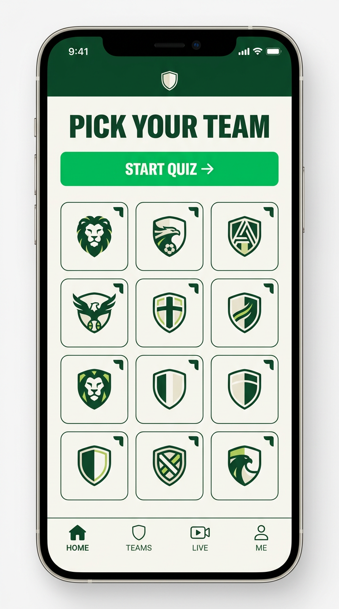
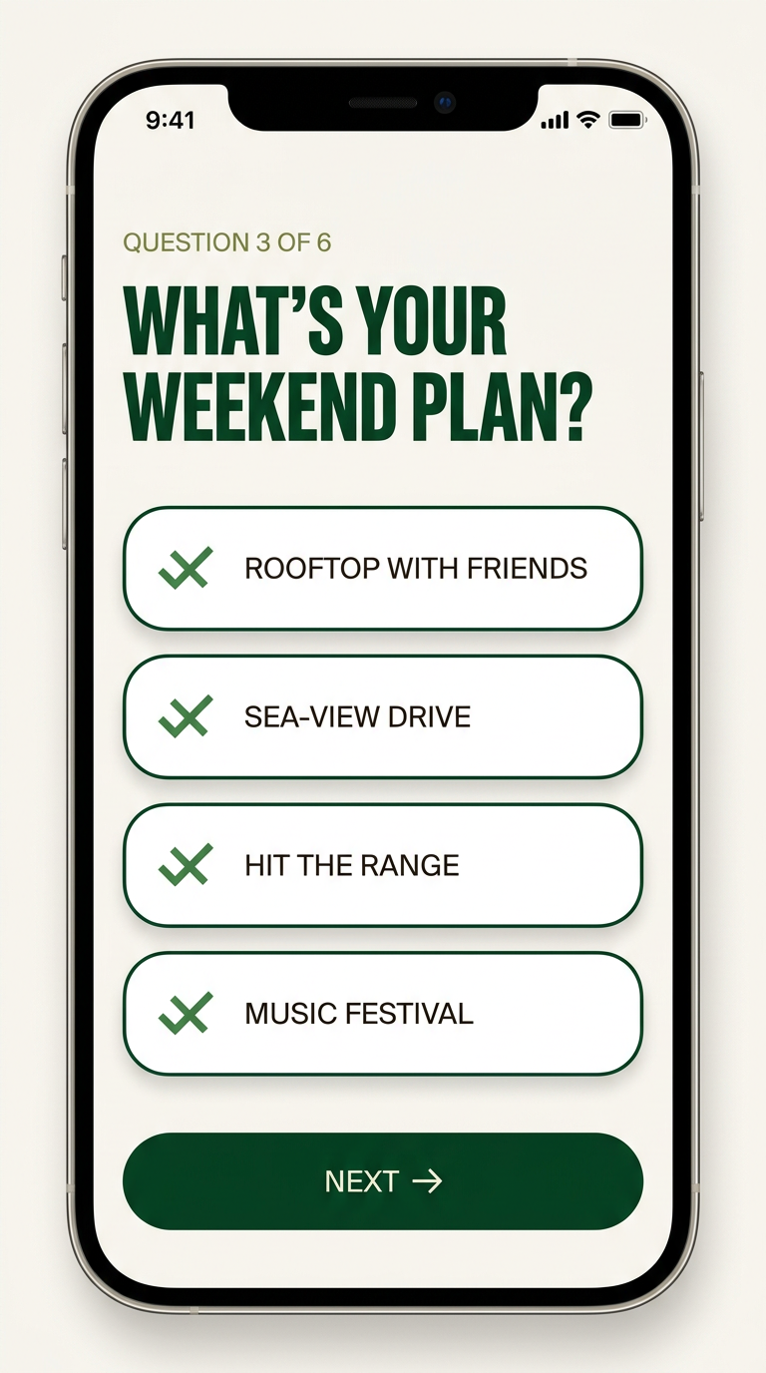
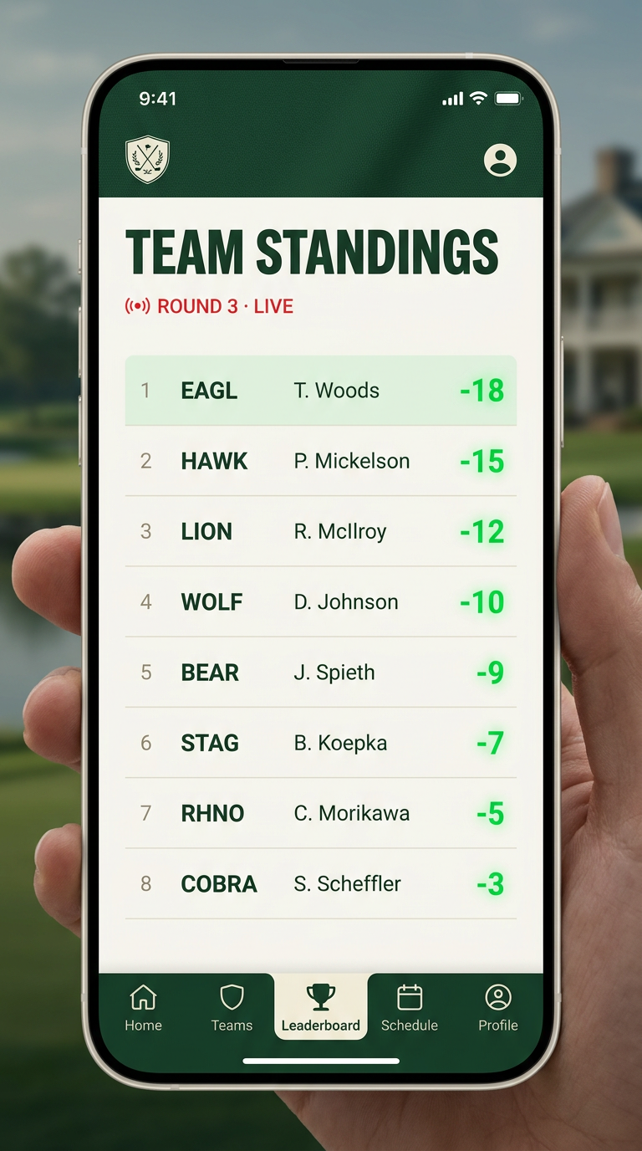
MINI PROGRAM · UI MOCKUPS
KRDS × LIV
WHAT THE
MINI PROGRAM
LOOKS LIKE.
THREE CORE FLOWS, DAY ONE
Team selection. Fan card creation. The
live team leaderboard. Built WeChat-first
for discovery, share, and weekly return.
HOME
TEAM SELECTOR
LIVE LEADERBOARD
DESIGN MOCKUPS — INDICATIVE
LIV GOLF CHINA · DIGITAL LAUNCH PROPOSAL
17 / 35

Slide 18
MINI PROGRAM · DELIVERY & GOVERNANCE
KRDS × LIV
MINI PROGRAM DELIVERY & GOVERNANCE
HOW WE SHIP THE OFFICIAL CHINA HUB.
ACCOUNT & ENTITY
HOSTING (PIPL)
WECHAT REVIEW
WeChat Open Platform account.
LIV China entity or KRDS as operator under MSA.
Tencent Cloud Shanghai region.
PIPIA + privacy notice + consent.
Processor/controller roles + DPO.
Mini Program submission → 7–14 day review.
Staged rollout. Content category: sports.
DATA FEED
MODERATION
RIGHTS & APPROVALS
LIV scoring API → MP leaderboard.
Fallback static cache if upstream latency.
24/7 comment moderation during event weeks.
Auto + human review. Crisis escalation SLA.
Team marks, player likeness, music licensing.
Sponsor + HSBC approvals for HK content.
KRDS RUNS DELIVERY END-TO-END · SENIOR TECH LEAD ASSIGNED FROM DAY ONE.
LIV GOLF CHINA · DIGITAL LAUNCH PROPOSAL
18 / 35

Slide 19
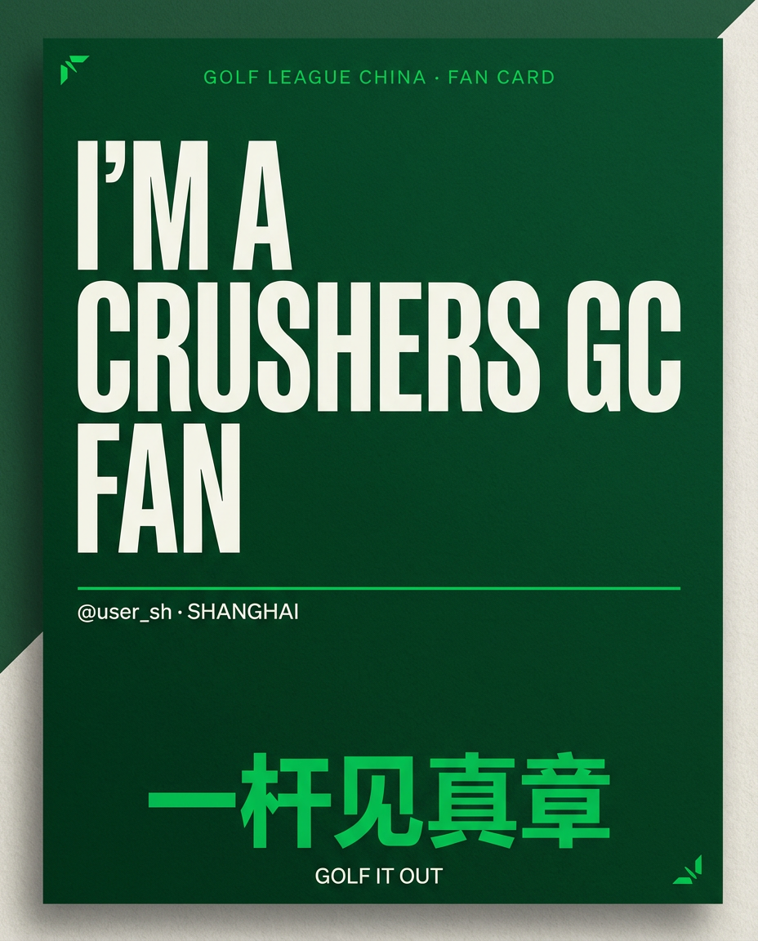
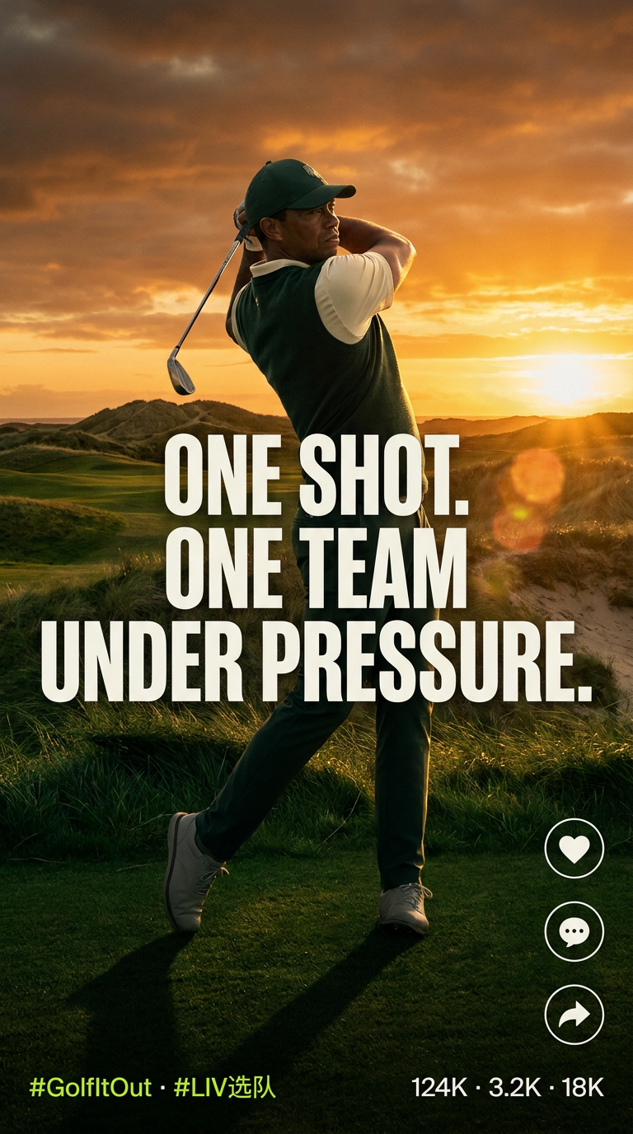
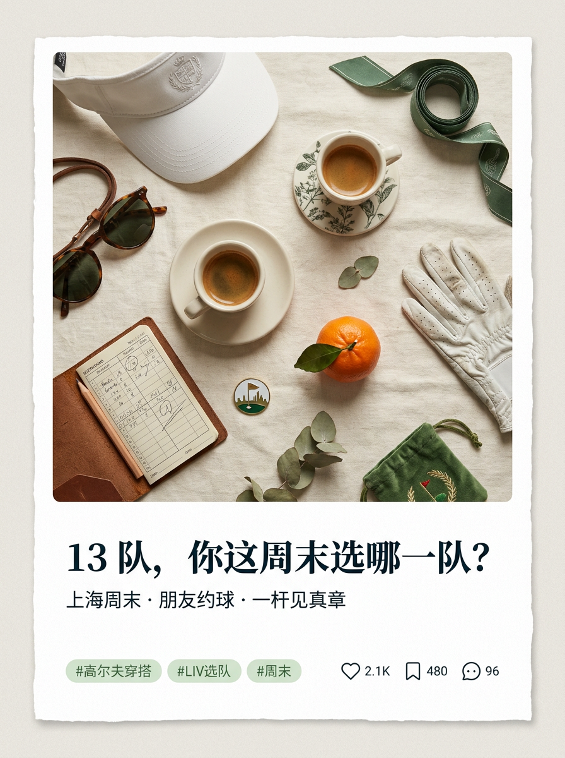
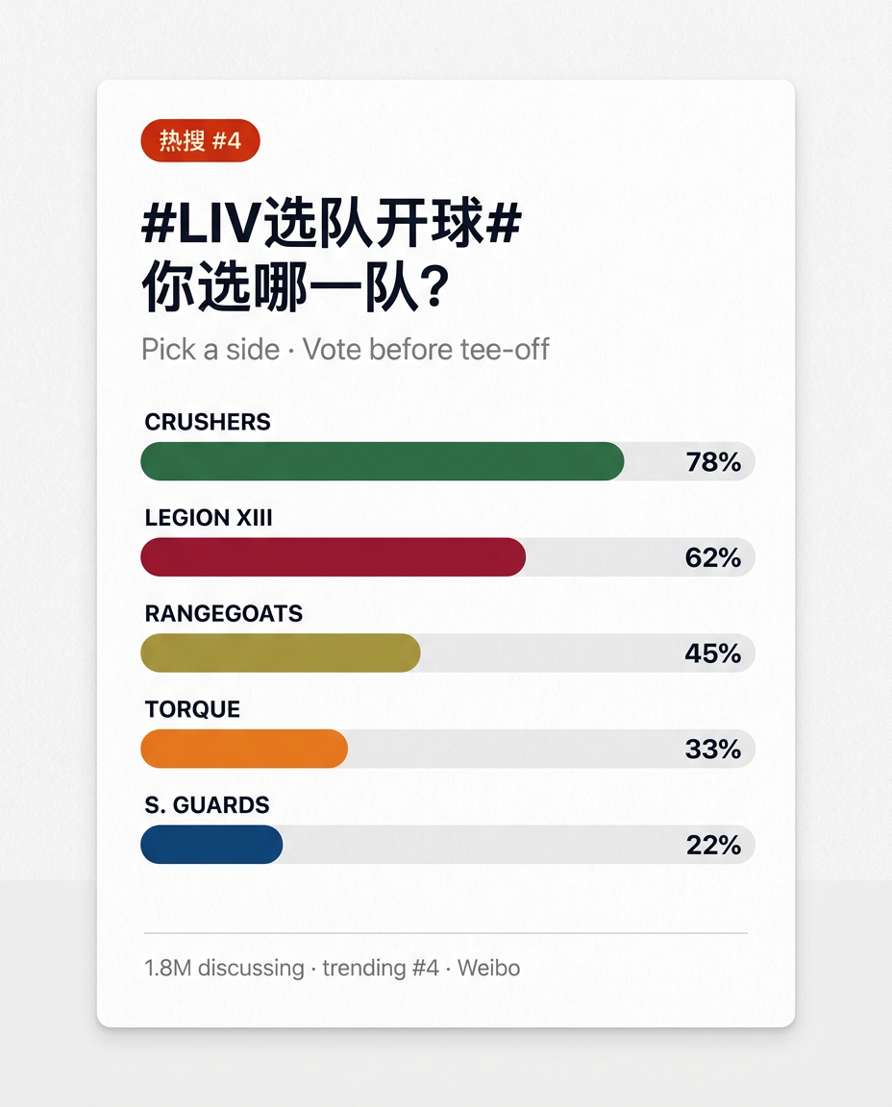
CREATIVE ARTIFACTS
KRDS × LIV
WHAT FANS SHARE OUT.
Identity, atmosphere, lifestyle, trending — one campaign, every platform.
CREATIVE MOCKUPS — INDICATIVE. PRODUCTION ASSETS BUILT IN WORKSHOP.
FAN CARD
DOUYIN
RED / 小红书
WEIBO
LIV GOLF CHINA · DIGITAL LAUNCH PROPOSAL
19 / 35

Slide 20
ANNUAL LAUNCH CALENDAR
KRDS × LIV
12 MONTHS.
6 PHASES.
2 PEAKS.
PHASE 1
PHASE 2
PHASE 3
PHASE 4
PHASE 5
PHASE 6
JUN-AUG '26
SEP-OCT '26
NOV '26
DEC-JAN '27
FEB '27
MAR-MAY '27
Foundation
Channels + MP build
Team education
Warm up audiences
MAINLAND PEAK
IS China pathway + Pick Your Team
Community nurture
Leaderboard + recap
HK PEAK
LIV HK Feb 18-21
Always-on league
Retention + next cycle
LIV GOLF CHINA · DIGITAL LAUNCH PROPOSAL
20 / 35

Slide 21
CAMPAIGN 1 · MAINLAND
KRDS × LIV
CAMPAIGN ONE · MAINLAND
PICK YOUR TEAM
选你的队，见真章
“Before you understand every rule — whose side are you on?”
MECHANISM
CRM JOURNEY
CONTENT + KOL
MP team selector quiz (6 Qs).
D0 Quiz → assigned team
“13 teams. One side.”
Personality → recommended team.
D1 Welcome series + captain intro
“上海，你站哪队？ / Shanghai — which side?”
Generates shareable fan card.
D3 Team poster unlock
“Captain vs captain — pick a side.”
Public KOL team declarations.
W1 Standings preview push
Top 2 celeb + 10 mid + 40 KOC.
City-level voting leaderboard.
Event-week Live leaderboard pings
Estimated talent: RMB 1.2–2.0M.
约战: KOL/city/brand 约战 board (weekly winner = live stunt hole).
Post-event Recap + next match-day
Hashtag #LIV站队 — Weibo trending.
TIMING — AROUND INT'L SERIES CHINA (NOV 5–8, 2026) · KPI — MP REG, FAN CARDS SHARED, TEAM VOTING
LIV GOLF CHINA · DIGITAL LAUNCH PROPOSAL
21 / 35

Slide 22
CAMPAIGN 2 · HONG KONG
KRDS × LIV
CAMPAIGN TWO · HONG KONG
GOLF IT OUT HONG KONG
一桿見真章 · 香港開波
“When LIV returns to Fanling Feb 18–21, 2027 — which team will prove itself?”
MECHANISM
CRM + CROSS-BORDER
CONTENT + KOL
Traditional Chinese + Cantonese.
Mainland fans → HK Hub push.
“揀隊，開波”
Fanling course knowledge series.
Pre-event: Fanling form guide.
“Fanling form guide.”
7-day Hong Kong Battle Week.
Battle Week: daily highlights.
“Which captain owns Hong Kong?”
Local food/style/music KOLs.
Live: leaderboard + city buzz.
5–8 Cantonese KOLs (IG/FB/RED).
MP Hong Kong Hub: standings.
Post: winning team + fan reactions.
Estimated talent: RMB 0.6–1.0M.
Mainland fans follow as climax.
Greater Bay travel tie-in.
Cross-border RED activation.
TIMING — LIV HONG KONG, FEB 18–21, 2027 (FANLING, 4TH EDITION) · KPI — HK FAN ACQ, CROSS-BORDER, HASHTAG
LIV GOLF CHINA · DIGITAL LAUNCH PROPOSAL
22 / 35

Slide 23
HONG KONG BATTLE WEEK
KRDS × LIV
MADE IN HONG KONG. NOT TRANSLATED.
HONG KONG BATTLE WEEK.
LANGUAGE
PLACE
CULTURE
GBA VISITORS
Cantonese-first captions, TC subtitles.
“揀隊” · “開波” · “點計分”
Hong Kong Golf Club, Fanling — host venue.
LIV HK 2027, Feb 18-21, 4th edition.
Dai pai dong, milk tea, rooftop bars,
Sham Shui Po street wear, MTR travel.
Shenzhen/GZ day-trippers.
WeChat Pay + Octopus dual flow.
7-DAY STORYBOARD
MON
TUE
WED
THU
FRI
SAT
SUN
TEASE
PRIMER
CAPTAINS
EVE
R1
R2
FINAL
Cantonese hooks — 揀隊
Fanling form guide
Head-to-heads
Walk-in atmosphere
Live leaderboard
Best shots + city buzz
Winner + reactions
CHANNELS — WECHAT + IG + RED + DOUYIN · CANTONESE-FIRST · MAINLAND CROSS-BORDER PUSH
LIV GOLF CHINA · DIGITAL LAUNCH PROPOSAL
23 / 35

Slide 24
ALWAYS-ON CONTENT ENGINE
KRDS × LIV
FIVE PILLARS.
ONE LEAGUE RHYTHM.
01 TEAM BATTLE
Rankings, captain matchups, rivalries, fan voting
02 PLAYER STORY
Star profiles, personalities, why-this-player-matters
03 LIV 101
Team scoring, shotgun start, no cuts, 72-hole format
04 EVENT ENERGY
City guides, live atmosphere, music & fan culture
05 LEADERBOARD DRAMA
Live shifts, “one shot changed everything”
LIV GOLF CHINA · DIGITAL LAUNCH PROPOSAL
24 / 35

Slide 25
ACTIVATION · KOL + PAID
KRDS × LIV
ACTIVATION
ORGANIC BUILDS IT. CREATORS + PAID SCALE IT.
KOL & CREATOR TIERS · TALENT (RMB)
PAID MEDIA FUNNEL · RECOMMENDED TIER
TIER
COUNT
ROLE
TALENT
AWARENESS
40–50% of spend
Douyin TopView, RED brand zone
Top
1–3
Brand validation
0.8–2.0M
PARTICIPATION
25% · CPE ~RMB 1.5
Mid
8–12
Weekly content
0.3–0.7M
MP retargeting, fan card boost
KOC
40+
Allegiance UGC
0.15–0.4M
COMMUNITY
15% · WeCom seed
WeChat group ads, CRM nurture
HK Canto
5–8
Local culture
0.2–0.45M
AMPLIFICATION
15% · peak windows
Event-week boosts, KOC waves
MEDIA SPEND BAND · RMB 4–10M (planned separately, not in agency fee)
BLENDED CPM RMB 20–35 · MP REG CVR 2–4% · YR1 REG TARGET 300K
LIV GOLF CHINA · DIGITAL LAUNCH PROPOSAL
25 / 35

Slide 26
RISK & REGULATORY
KRDS × LIV
WE PLAN FOR
THE CHINA TRAPS.
CONTENT APPROVAL
PLATFORM POLICY
广电/体育总局 broadcast-rights filing. No 竞猜 language. Athlete image rights.
WeChat MP review cycles, Douyin sports category rules
MUSIC LICENSING
DATA / PRIVACY
Use Chinese-rights-cleared sound libraries for short video
PIPL-compliant CRM, on-shore data, clear consent in MP
HK ↔ MAINLAND
CRISIS PROTOCOL
Separate content tracks, distinct language and cultural cues
24h monitoring at peak weeks. Saudi PIF + HK NSL pre-vetting on all copy.
LIV GOLF CHINA · DIGITAL LAUNCH PROPOSAL
26 / 35

Slide 27
MEASUREMENT FRAMEWORK
KRDS × LIV
KPIS BY FUNNEL STAGE.
STAGE
METRIC
SCENARIO TARGET (RECOMMENDED + PAID)
Awareness
Total impressions, paid + organic
350M+
Awareness
Hashtag reads (#LIV站队, etc.)
100M+
Engagement
Engagement rate on owned content
>5%
Engagement
KOL/KOC posts shipped
60+
Participation
Mini Program registrations
300K+
Participation
Fan cards shared
150K+
ALLEGIANCE
Users who pick a team (% of MP visitors)
>60%
ALLEGIANCE
Rival-team engagement ratio
>1.2×
ALLEGIANCE
Captain share-of-voice (top 3)
>35%
Community
CRM opt-ins / WeChat OA followers
200K+
Community
Repeat MP visits during peak weeks
>40%
Indicative scenario targets based on Recommended tier plus paid media support — refined after channel baselining in Phase 1.
LIV GOLF CHINA · DIGITAL LAUNCH PROPOSAL
27 / 35

Slide 28
KRDS SCOPE OF WORK
KRDS × LIV
WHAT WE DELIVER.
STRATEGY
CREATIVE
Annual plan · audience · platform · measurement · localization
Big idea steward · campaign creative · copy (SC/TC/Cantonese)
PLATFORMS
MINI PROGRAM
WeChat OA + Channels · Douyin · RED · Weibo · Bilibili (optional)
IA · UX/UI · team selector · fan card · leaderboard · CRM
KOL & PAID
EVENTS
Tiered KOL mapping · briefing · paid media planning & buying
IS China + LIV HK content support · pre/live/post coverage
CRM & DATA
REPORTING
PIPL-compliant capture · segmentation · lifecycle journeys
Monthly performance · quarterly strategic optimization
LIV GOLF CHINA · DIGITAL LAUNCH PROPOSAL
28 / 35

Slide 29
SOW · STAFFING · GOVERNANCE
KRDS × LIV
HOW WE STAFF + GOVERN
SENIOR-LED POD. CLEAR DECISION RIGHTS.
LAUNCH POD (FTE)
GOVERNANCE & RACI
Account Director
0.5 FTE
CADENCE
WHO
PURPOSE
Strategy Director
0.5 FTE
Weekly status
Pod + LIV PM
Sprint check + risks
Creative Director
0.4 FTE
Bi-weekly creative
ECD + LIV brand
Idea + asset reviews
Mini Program Tech Lead
0.6 FTE
Monthly perf
Strat + LIV CMO
KPIs + optimisation
Social Ops Lead (×2 MN/HK)
2.0 FTE
Quarterly business
AD + LIV exec
Scope + budget + roadmap
KOL/Community Lead
0.7 FTE
Crisis (24h)
AD + LIV legal/PR
Issue triage + decisions
Producer (video/photo)
0.6 FTE
Data + reporting
0.4 FTE
EXCLUSIONS — TICKETING, ECOMMERCE, OFFLINE EVENT PRODUCTION. · DEPENDENCIES — LIV DATA FEED, RIGHTS.
LIV GOLF CHINA · DIGITAL LAUNCH PROPOSAL
29 / 35

Slide 30
TIMELINE & PHASING
KRDS × LIV
CONTRACT TO
HK CLIMAX.
MONTH 0
M 1–3
M 4–5
M 6
M 7–8
M 9
M 10–12
Sign + onboard
Foundation (channels, MP, identity)
Team education + warm-up
Mainland peak — Pick Your Team
Community nurture
HK peak — Golf It Out HK
Always-on league + next cycle
LIV GOLF CHINA · DIGITAL LAUNCH PROPOSAL
30 / 35

Slide 31
INVESTMENT · TIERS
KRDS × LIV
THREE TIERS.
ONE LEAGUE TO BUILD.
Annual fees. Paid media planned separately by launch ambition. Indicative; firmed at SOW.
LEAN LAUNCH
RECOMMENDED
HERO LAUNCH
PICK
RMB 3.0 – 4.0M
RMB 6.5 – 9.5M
RMB 11 – 15M
Strategy + 2 core social channels.
Light KOC seeding.
MP info hub.
Monthly reporting.
Full strategy + WeChat / Douyin / RED / Weibo.
MP w/ team selector + fan cards + CRM.
2 hero campaigns + KOL waves.
Event-period content support.
Recommended + higher-volume video.
Larger KOL partnerships.
HK on-ground production team.
Live event content + enhanced MP.
LIV GOLF CHINA · DIGITAL LAUNCH PROPOSAL
31 / 35

Slide 32
INVESTMENT · HOW THE NUMBER IS BUILT
KRDS × LIV
INVESTMENT · RECOMMENDED TIER
LINE-ITEM BUILD-UP.
How the Recommended-tier number is built. Annual fees, RMB thousands, ex media spend.
LINE ITEM
WHAT'S INCLUDED
RMB (000)
Strategy & planning
Senior strategy, annual planning, measurement
700 – 1,000K
Content operations
WeChat OA + Channels + Douyin + RED + Weibo + B站
1,600 – 2,100K
Vertical video studio
Dedicated Douyin/RED shoot cell, vertical at scale
300 – 500K
Mini Program build + maint.
IA, UX/UI, team selector, fan card, CRM, hosting
800 – 1,150K
KOL/KOC management fee
Tier mapping, briefing, coord. (talent pass-thru sep)
500 – 750K
Paid media mgmt + OTT/CTV
8–12% of spend + Tencent/Migu/iQiyi planning
650 – 1,050K
Production
Hero film, key visuals, motion, photo
800 – 1,300K
Event support (IS + LIV HK)
Pre / live / post coverage, on-the-ground
700 – 1,000K
Compliance & moderation
PIPL DPO, IP review, 24/7 moderation, SC/TC QA
500 – 800K
Private domain ops
WeCom super-fan groups, T1 customer journeys
200 – 400K
Reporting & optimization
Monthly + quarterly review + AI tooling
250 – 450K
Tech pass-through
Tencent Cloud, SMS/auth, WeCom, AI subs
120 – 200K
TOTAL (ANNUAL)
Agency fees only. Adds up to Recommended tier RMB 6.5–9.5M.
6,500 – 9,500
+ KOL TALENT PASS-THROUGH
Itemised separately, not agency margin
3,000 – 5,500
Ranges in RMB thousands. Agency fees only. Excludes paid media spend, KOL talent and tech pass-through. Benchmarked against China agency rate cards (R3, Campaign Asia, Hashmeta, Mr Discovery 2025).
LIV GOLF CHINA · DIGITAL LAUNCH PROPOSAL
32 / 35

Slide 33
WHY KRDS
KRDS × LIV
THE GREATER CHINA
DIGITAL PARTNER
LIV NEEDS.
FRENCH-FOUNDED, APAC-NATIVE
Founded 2008. Offices: Paris HQ + Shanghai + Hong Kong + Singapore + Mumbai + Dubai.
CHINA SOCIAL DNA
Engaging China audiences since 2011 — WeChat-first practice older than the platform's market dominance.
MP + CRM PRACTICE
End-to-end Mini Program: IA, UX/UI, leaderboard integration, PIPL hosting, CRM.
REFERENCE WORK
Public case: “Traveling The World for Air France.” 3 China cases shared at next session.
LAUNCH-POD MODEL
Senior strategy lead + dedicated pod across Mainland and HK — not a junior team.
REFERENCE WORK — 3 CASES READY FOR NEXT SESSION
AIR FRANCE
LVMH
HERMÈS
Global digital · WeChat · “Travelling The World” campaign
Luxury portfolio · China · WeChat + RED activation (NDA)
Brand storytelling · WeChat · Mini Program + CRM (NDA)
LIV GOLF CHINA · DIGITAL LAUNCH PROPOSAL
33 / 35

Slide 34
THE ASK · NEXT 30 DAYS
KRDS × LIV
THE ASK
RECOMMENDED TIER.
SIGN-OFF IN 30 DAYS.
MAINLAND LAUNCH NOV 5.
WEEK-BY-WEEK FROM TODAY
W1
W2
W3
W4
SIGN MSA + SCOPE LOCK
POD ONBOARDING + KRDS CASES
MP TECHNICAL KICKOFF
PHASE 1 PLAN LOCKED
AD + LIV procurement
Strategy + creative leads
Tech lead + LIV API team
Full pod live
WHY RECOMMENDED, NOT LEAN
Lean underdelivers on MP, KOL pod, and HK launch — Recommended is the floor for a credible Greater China launch.
DECISION GATE — RECOMMENDED TIER COMMITMENT BY [DATE] · PHASE 1 GO-LIVE 90 DAYS LATER.
LIV GOLF CHINA · DIGITAL LAUNCH PROPOSAL
34 / 35

Slide 35

ONE MORE THING
DON'T LAUNCH A
GOLF EVENT.
LAUNCH A TEAM LEAGUE
CHINESE AUDIENCES CAN
BACK, FOLLOW, AND
RALLY BEHIND.
GOLF IT OUT · 一杆见真章
35 / 35

